Slide 1
Hope for the Journey Home Update
What we are doing differently as we re-open

Slide 2
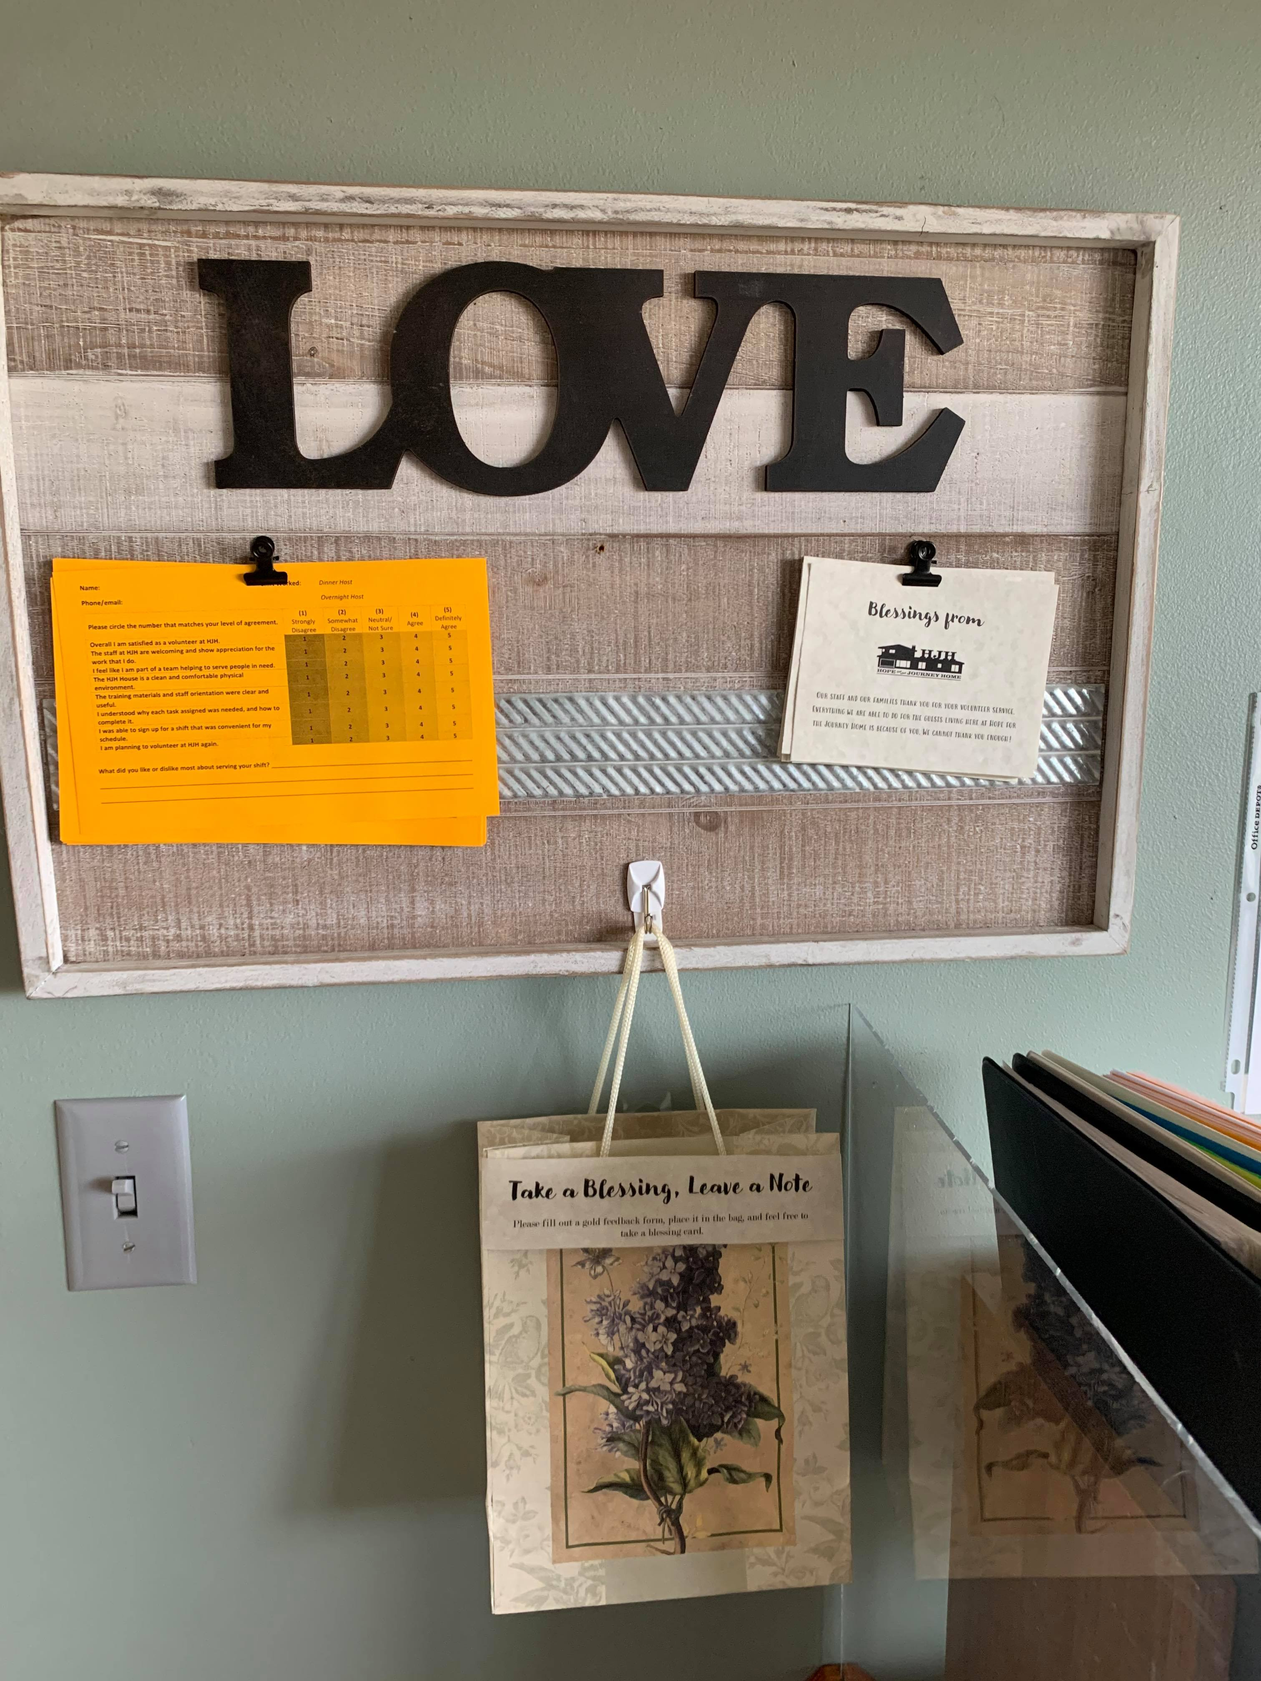
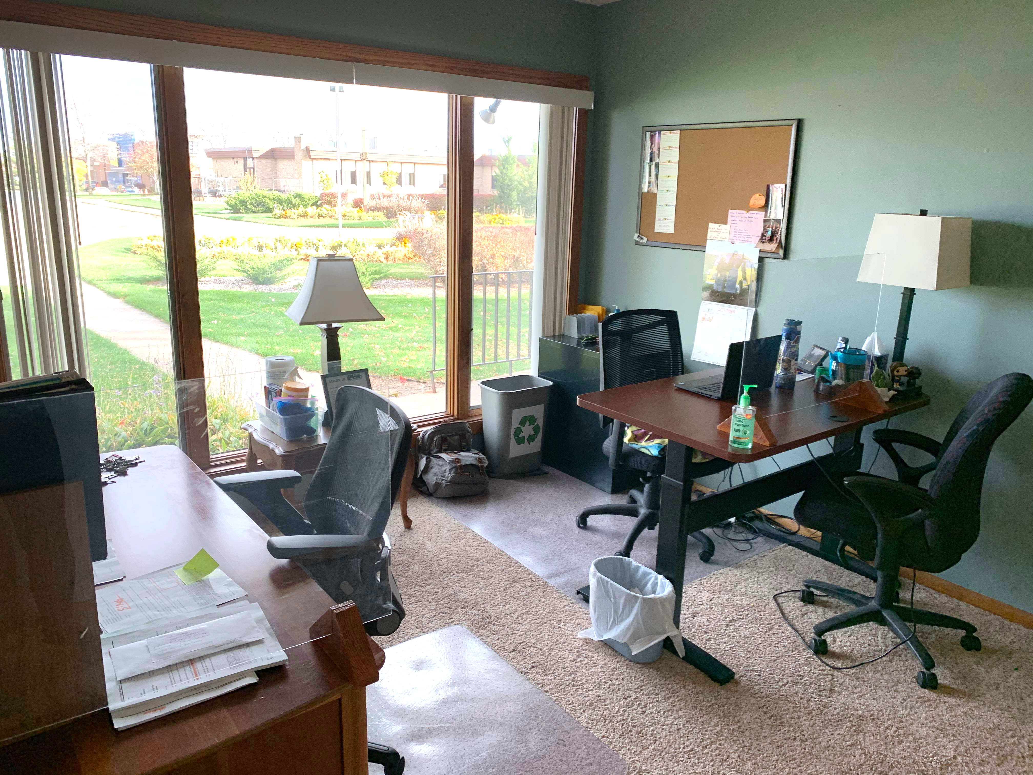
House Tour - Front entryway
Volunteer Coordinators Desk
Volunteer/Family Sign In
Temperature Check and Health Questions
New Feedback

Slide 3
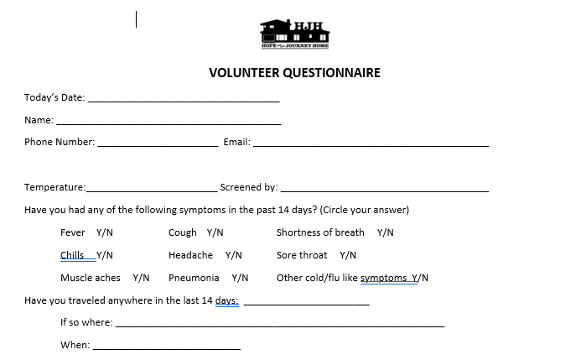
paperwork for volunteers
Regular Code of Conduct form
Regular sign in
What’s New?:
Health Questionnaire and Temperature Check
Assumption of Risk

Slide 4
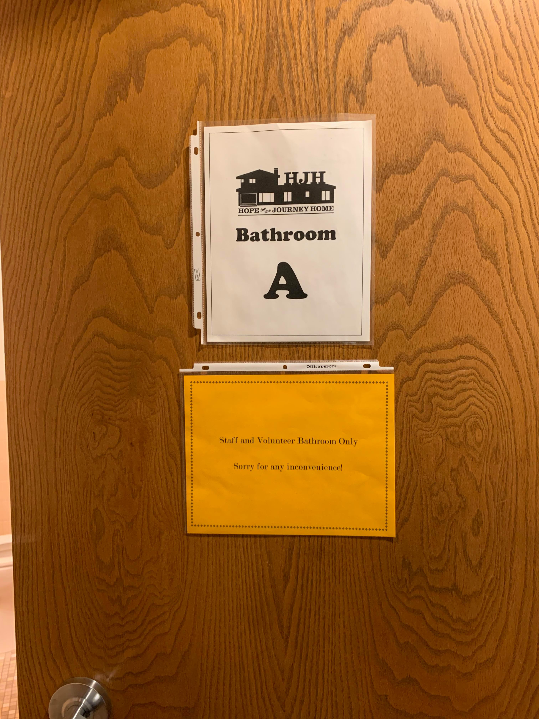
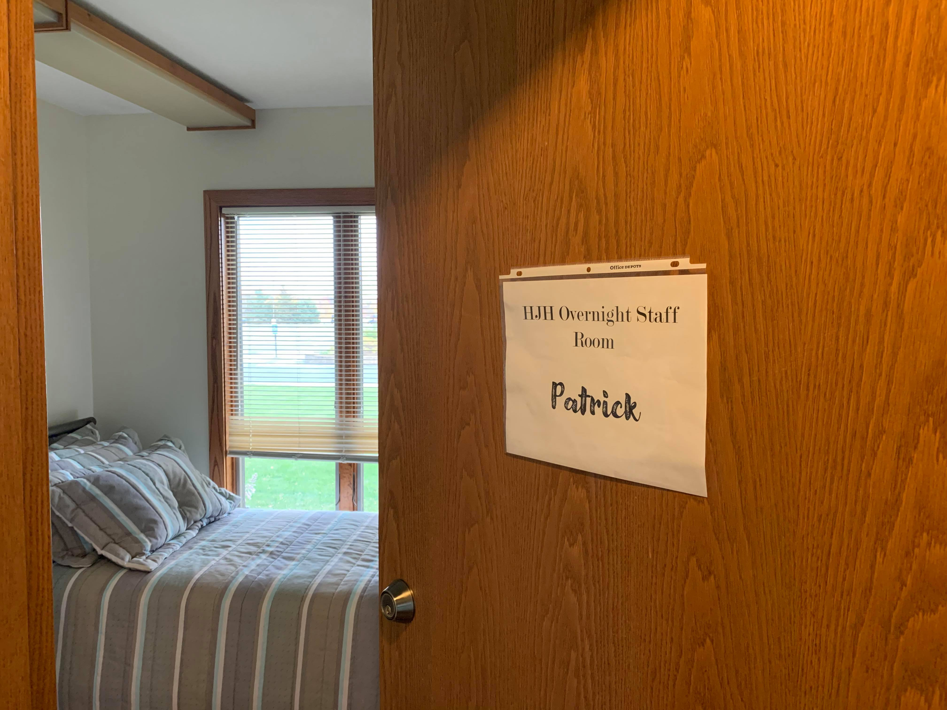
House Tour – Hallway (overnight and bathrooms)
Former office is a paid overnight room
Both bathrooms will be for staff and volunteers only
Guests have private bathroom

Slide 5
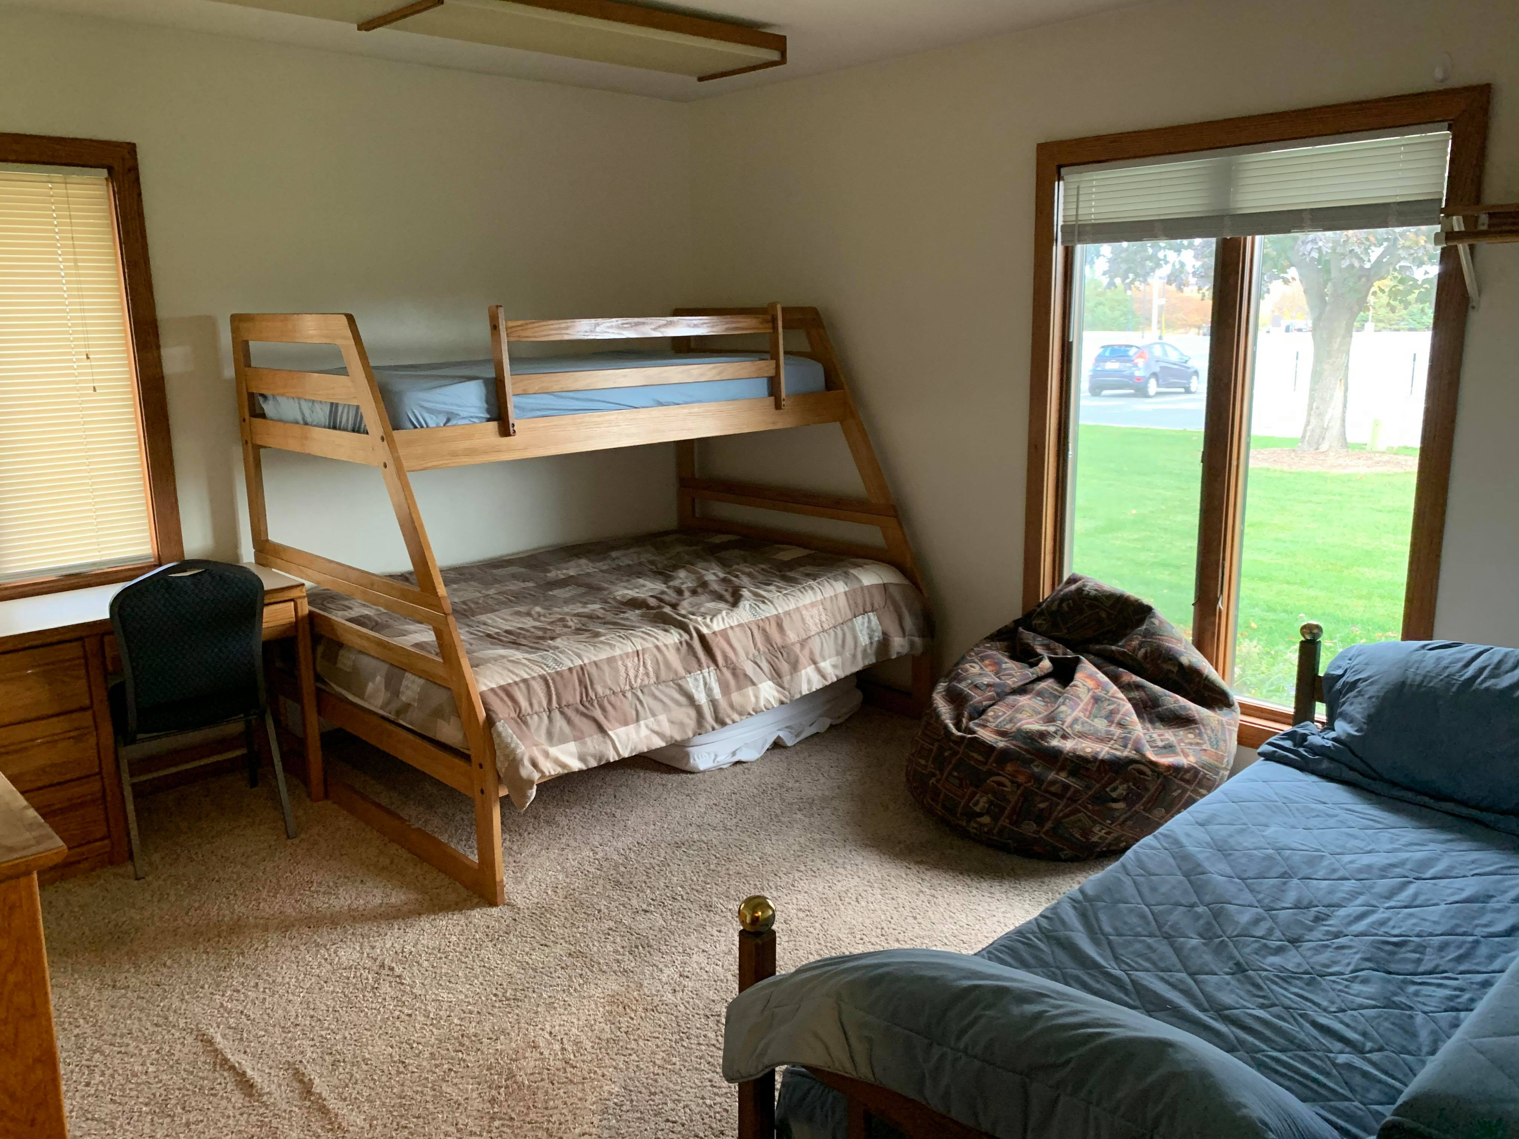
House Tour – End of hallway and family rooms
Combined two guest rooms at the end of the hallway into one “suite style” room.
One room is for sleeping and the other is a family room.
Private bathroom

Slide 6
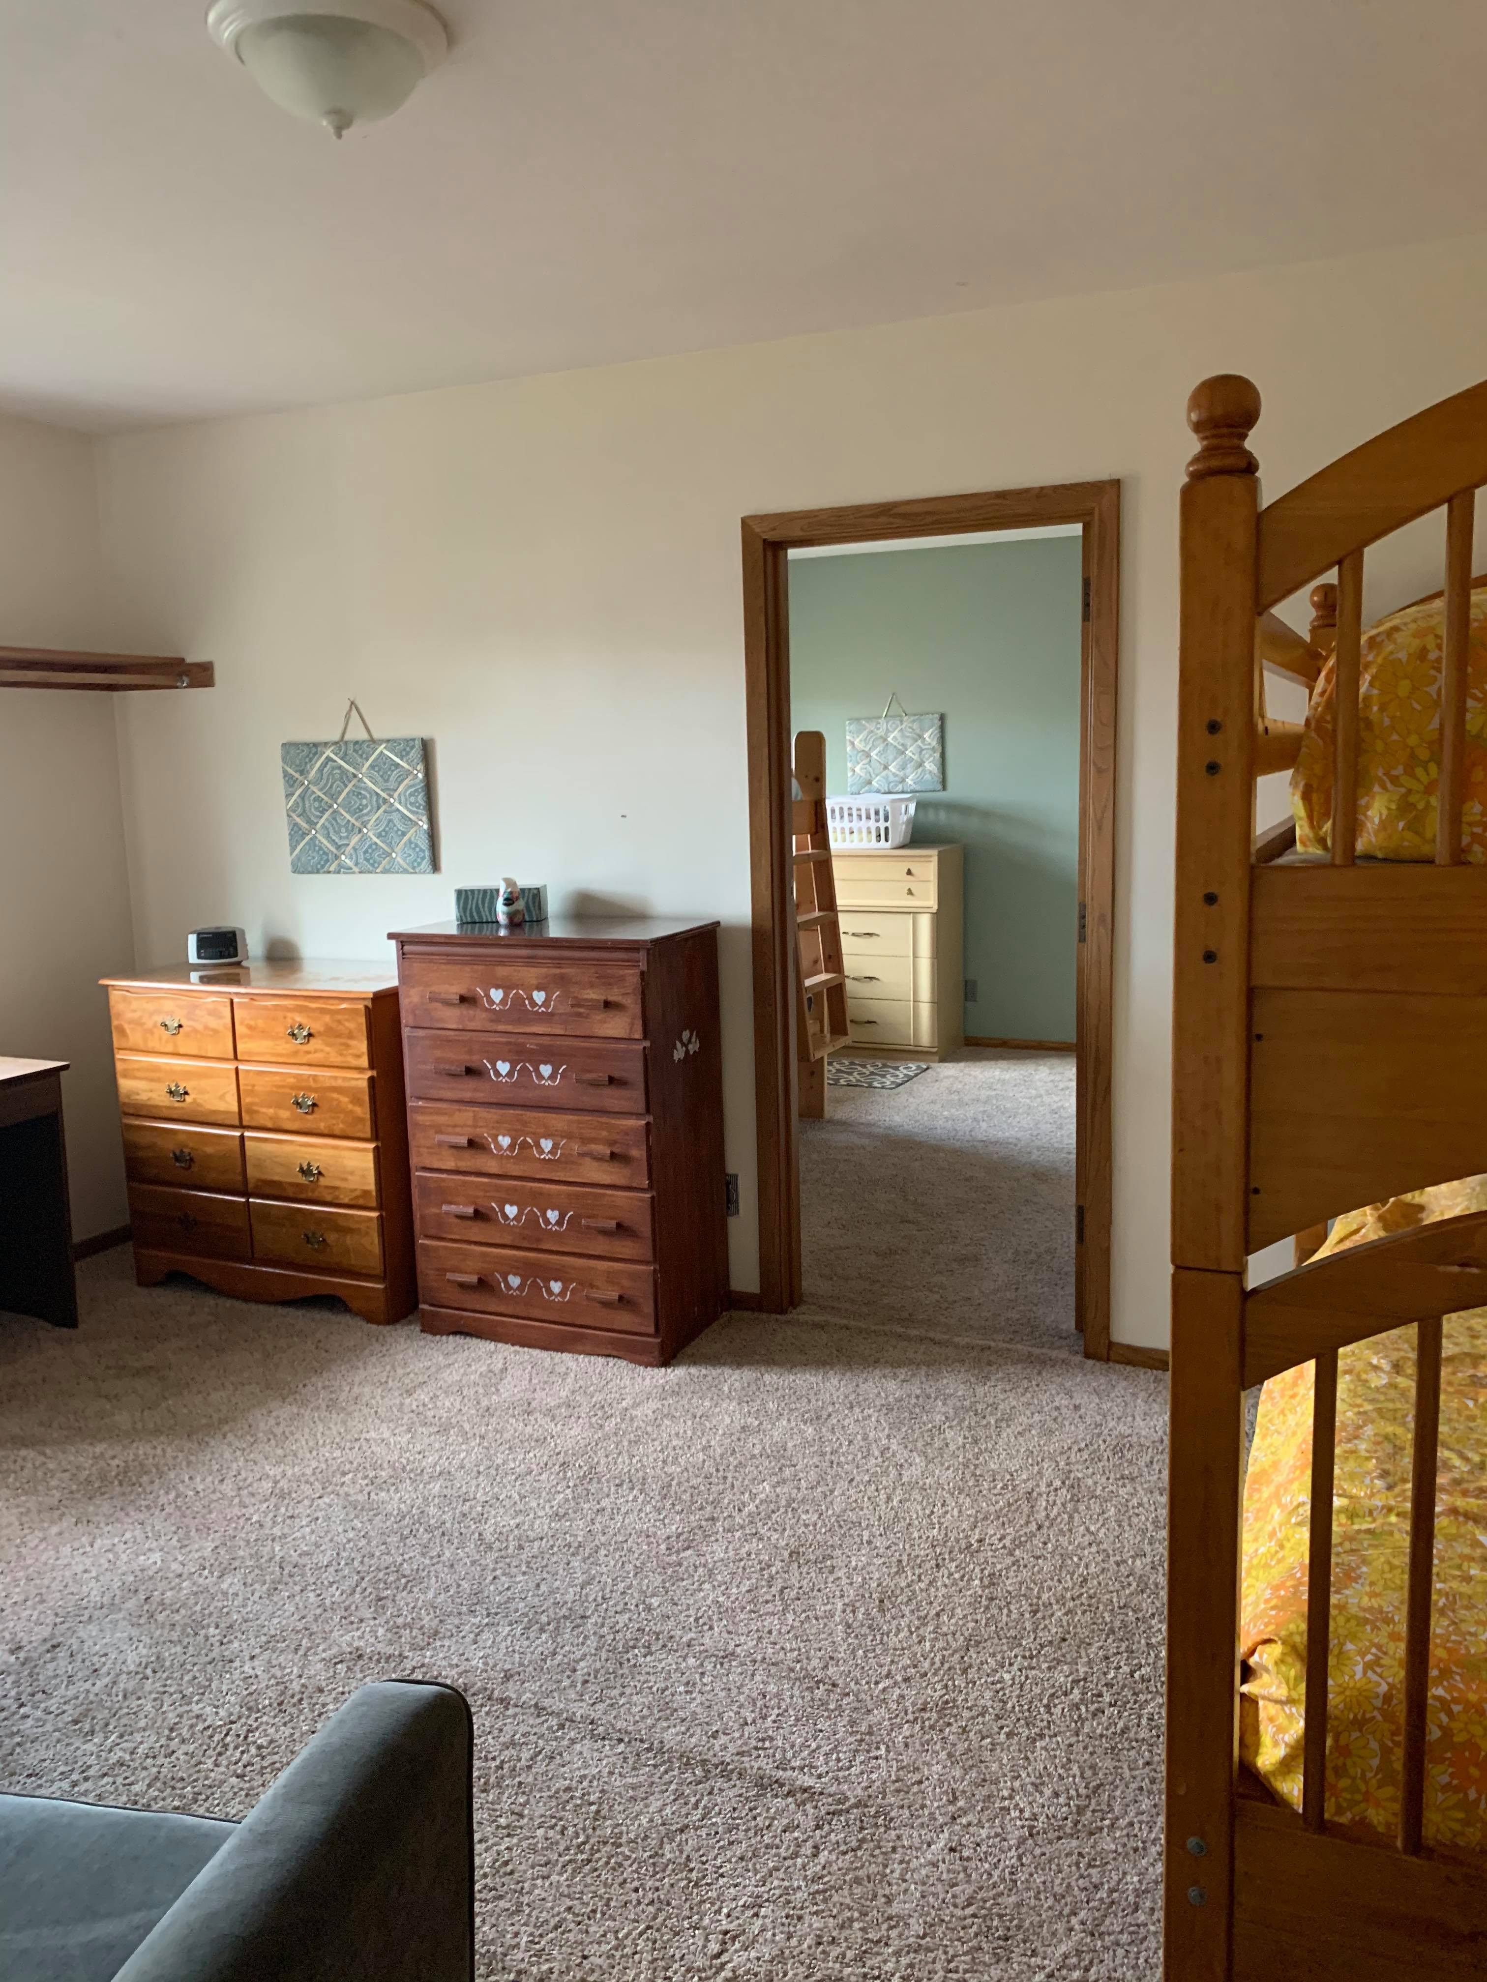
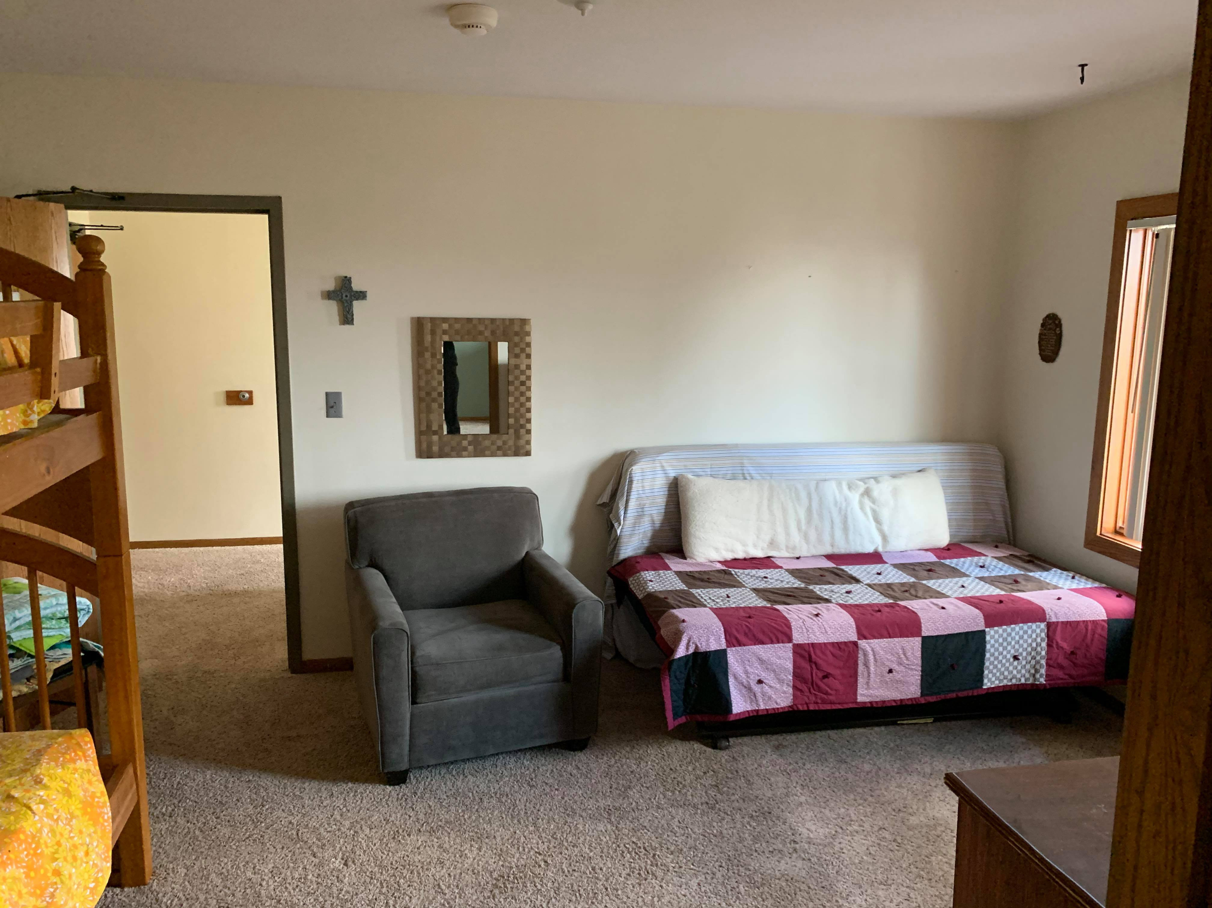
House Tour – Upstairs
Same sleeping room/family room arrangement upstairs
Private bathroom upstairs

Slide 7
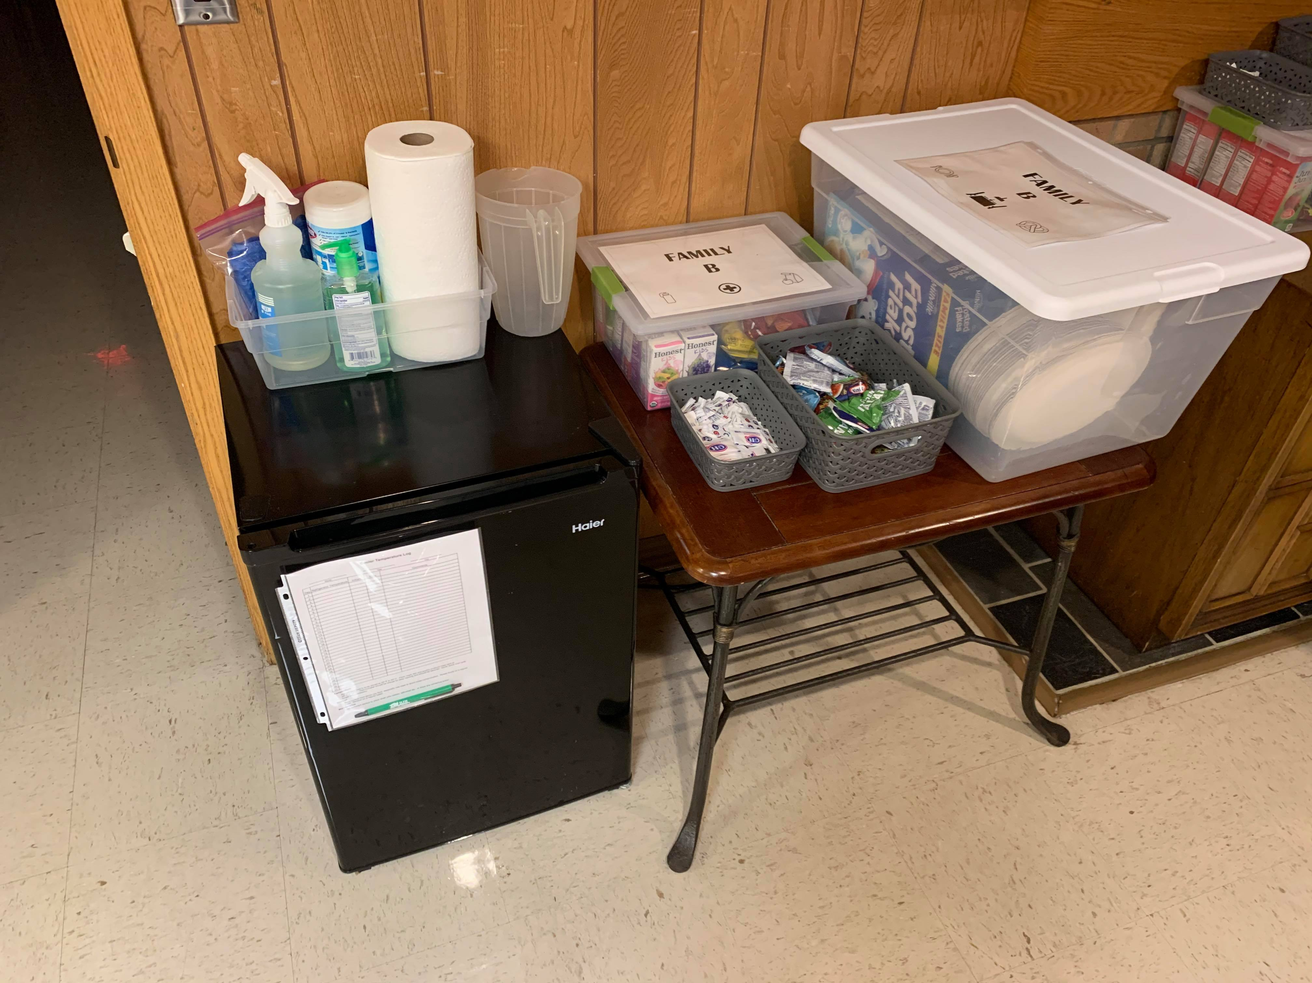
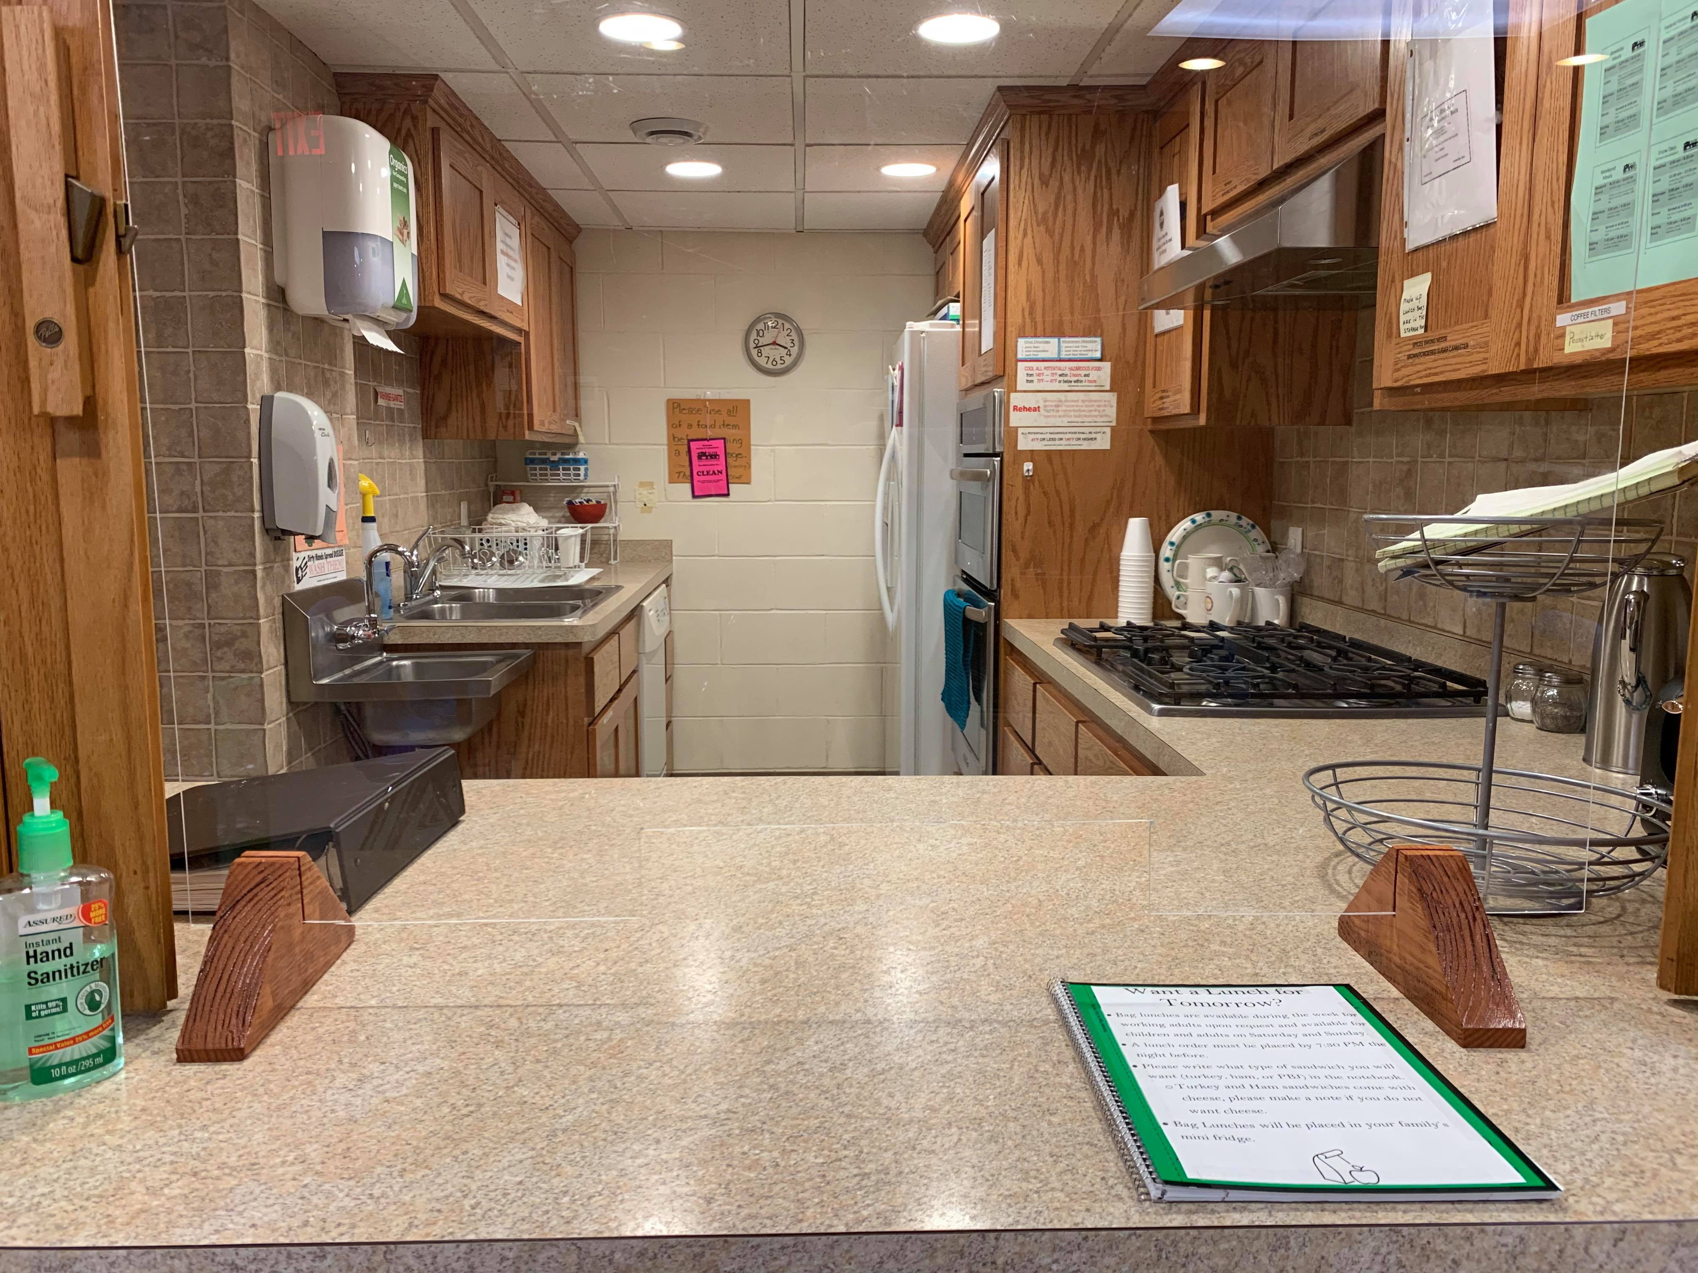
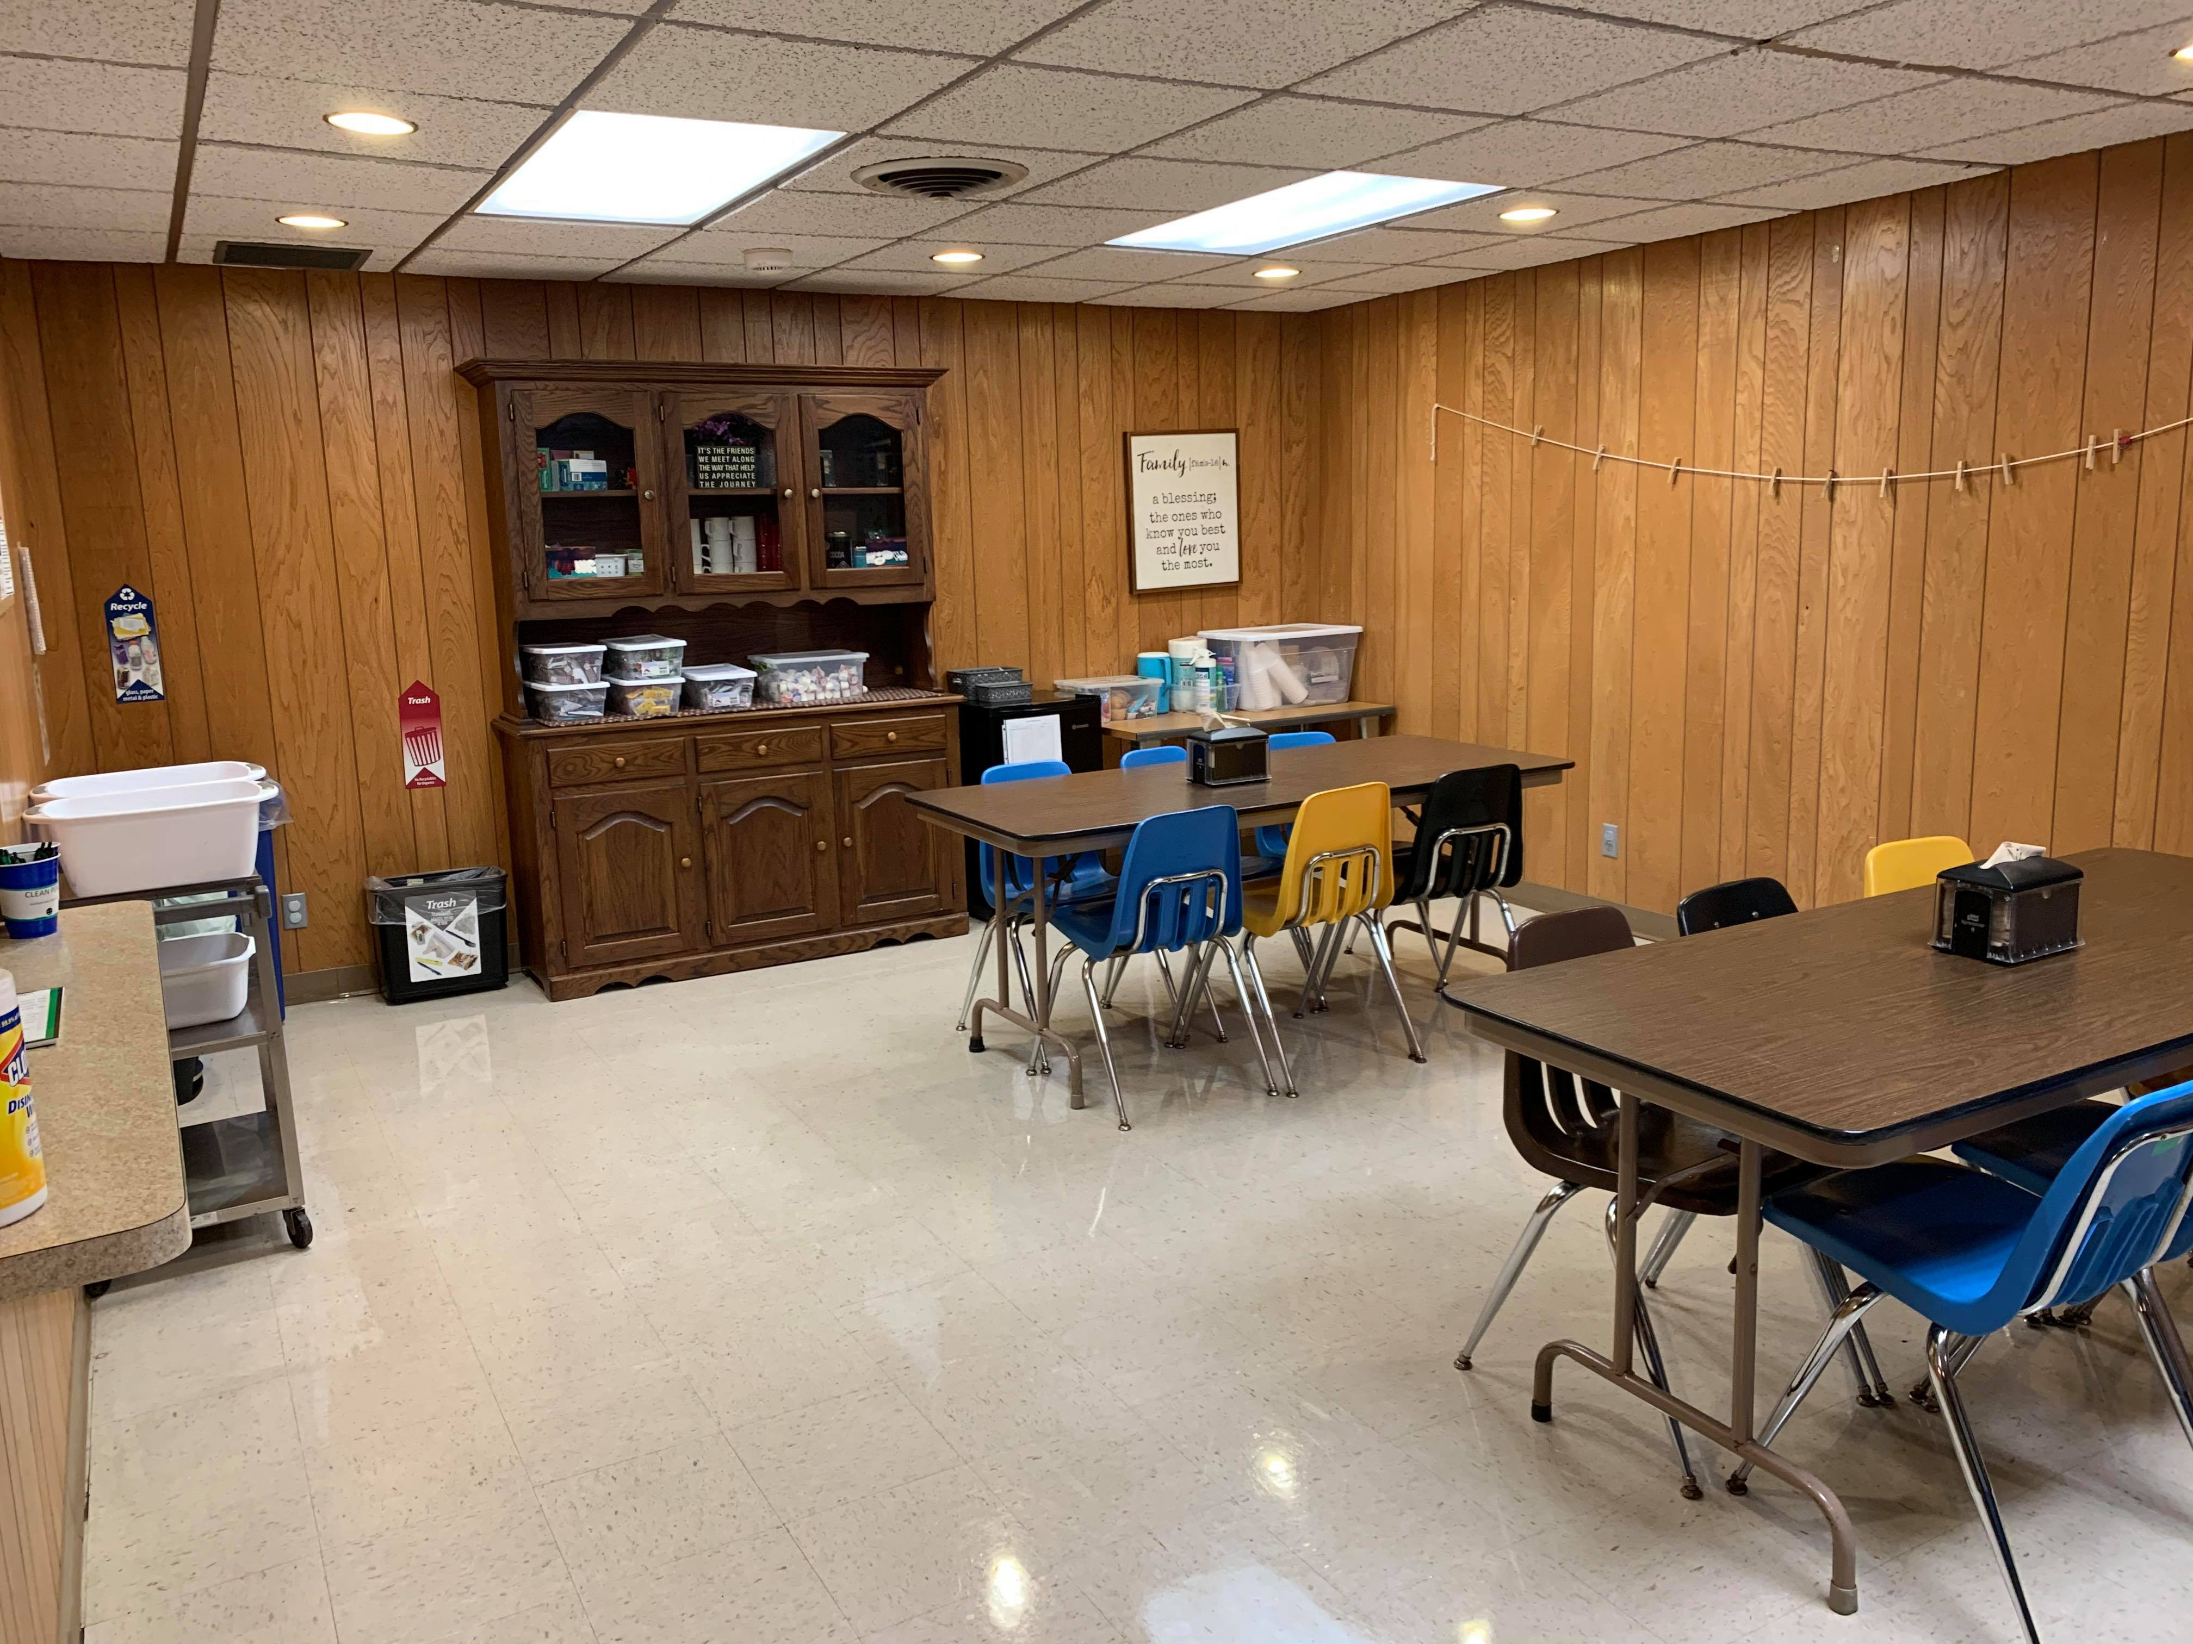
House Tour – Kitchen and Dining room
No accessible furniture in front of TV
Family specific tables and bins to hold dishware, snacks, and condiments
Plexiglass
Designated Volunteer and Staff table

Slide 8
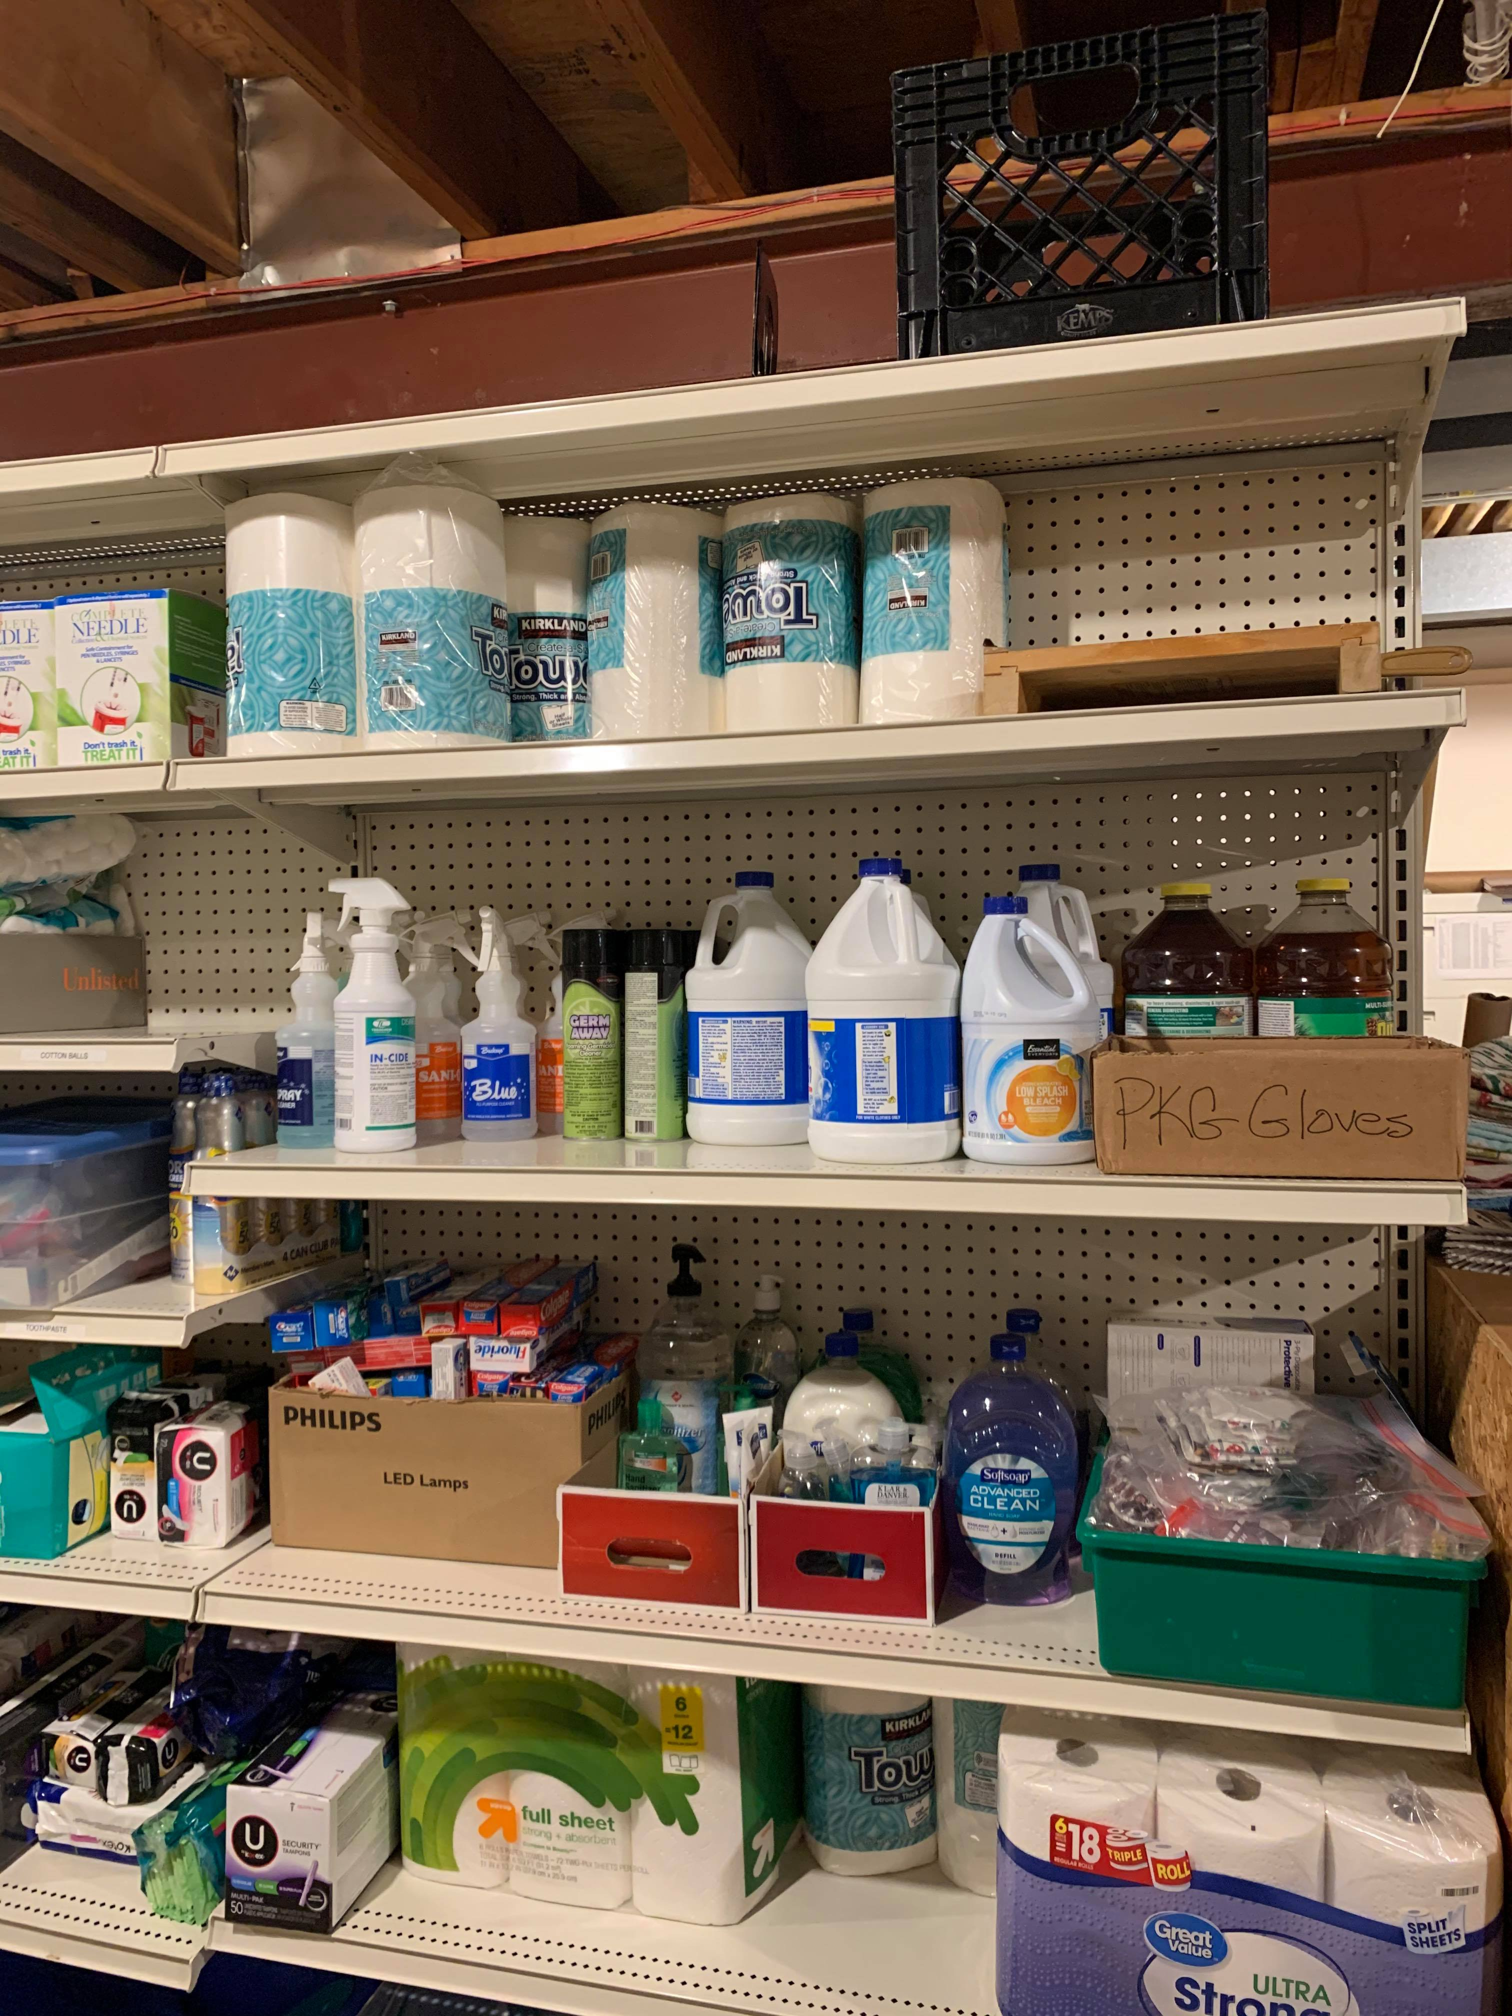
House Tour – Storage Room
COVID – 19 supply shelf

Slide 9
Volunteer Roles – Dinner Shift
Dinner Shift still available starting between 4:30-5PM and ending between 7-7:30PM
NEW: Serving dinner on Thursday evenings
Meals may be easier to prepare than in the past
Volunteers will serve guests behind plexiglass
Separate table for Staff and Volunteers
Enjoy meal and converse with guests while a safe distance away
Plexiglass at table and serving area
Light house keeping tasks to complete (revised list)

Slide 10
Volunteer Roles – overnight shift
New paid Overnight Staff
Continue to need at least one volunteer. Two may volunteer as in past
Optional Time Change
Regular 8:00 pm to 9:00 am
Continue to pack lunches and prepare breakfast in the morning
Families breakfast items are in family bin and mini-refrigerator
As short as 9:00 pm to 7 am
Would essentially “get in, get out” and not have to interact with guests if concerned about face to interaction due to COVID-19

Slide 11
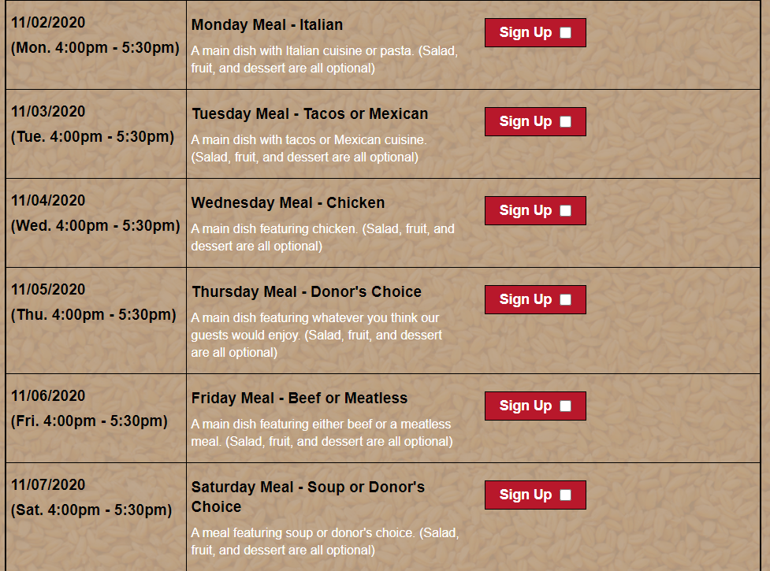
Volunteer Roles – Meal donations
Volunteers sign up individually or can be coordinated by Volunteer Coordinators
Meal Drop off between 4:00 pm – 5:00 pm or arrange a time.
Drop off meal daily, a few at a time or a week’s worth starting on Sunday.
Meal must be store bought, no homemade meals. Easy for us to prepare such as put in oven or crockpot
Great places to look:
Costco
Sam’s Club
Local grocery stores
Contactless drop-off
Opportunity for those that do not feel it is in their best interest to volunteer in the house currently
Meal suggestions are suggestions! Don’t feel limited to what is on the list
Meals for Hope Sign UP :
https://www.signupgenius.com/go/10C0D4FADAC2FA0F5C34-meals4

Slide 12
Volunteer roles – New front desk position
CRC is currently not open to guests 9-3 as in the past.
HJH will be open 24/7 to guests
Seeking volunteers willing to fill the staffing gap from 8:45 am to 2:00 pm
Volunteer part of a day
Minimal contact with guests
Answering phone, and door. Welcoming guests and those dropping off donations
Most days this would be time to work on personal hobbies (like knitting) or read a book
Great opportunity for college aged youth and older

